Slide 1

DATA SCIENCE
10 WEEK PART TIME COURSE
Week 3 - Logistic Regression

Slide 2
AGENDA
Motivation
What is Logistic Regression?
Why use Logistic Regression
Lab
Homework Review

Slide 3
SUPERVISED LEARNING - REGRESSION & CLASSIFICATION
If the y variable is numeric then we have a regression problem - we are trying to predict a continuous number
If the y variable is a category (for example trying to predict a type of flower) the we have a classification problem - we are trying to classify what group that y belongs to.

Slide 4
WHAT TO USE & WHEN
The more _____ and the more ____, but the less ____ means a higher probability of ______
Logistic regression will probably work
The model will be comprehensible

Slide 5
WHAT TO USE & WHEN
The more young children you are looking after and the more hungry you are, but the less alternative eating options in your area means a higher probability of you eating dinner tonight at McDonalds.
Logistic regression will probably work
The model will be comprehensible

Slide 6
WHEN LOGISTIC REGRESSION WON’T WORK WELL
You are more likely to ____ if _____ unless _____, in which case _____
A decision tree will probably work better
There’s this complicated mathematical function that relates ____ and ____ to the probability of _____
Try a support vector machine

Slide 7
WHEN LOGISTIC REGRESSION WON’T WORK WELL
You are more likely to buy a bright pink phone case if your age is between 8 and 14 unless you have more than twenty cases already, in which case it is between the ages of 40 and 60.
A decision tree will probably work better
If the square of the number of items bought divided by the average cost is greater than 1 then probability of an item return increases.
Try a support vector machine

Slide 8
WHAT IS STEP REGRESSION?
DATA SCIENCE PART TIME COURSE

Slide 9
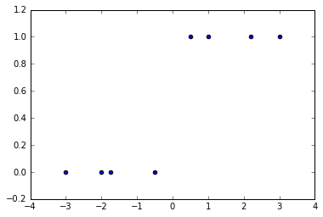
Regression against a step-function
Turn your category into a number:
“In category” = 1
“Not in category” = 0
Find the break point.
Suggested regression:
F(x) = 0 when x < 0
F(x) = 1 when x >= 0
And buy yourself a lottery ticket, because nothing ever works out this well

Slide 10
WHAT IS LOGISTIC REGRESSION?
DATA SCIENCE PART TIME COURSE

Slide 11
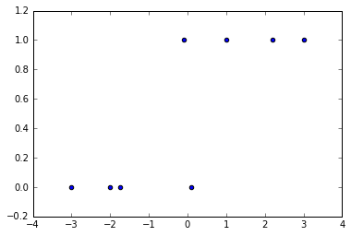
The best you could hope for really…
Near x=0, we don’t know what category to choose: 50% either way
F(x) = close to zero if x is really negative
F(x) = close to one if x is really positive
F(x) = 0.5 if x is near zero

Slide 12
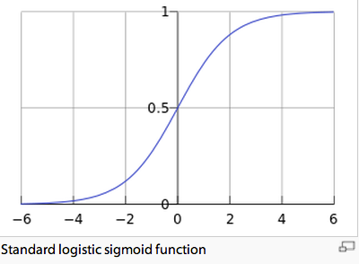
Let’s smooth that function a bit
We can adjust the slope.
We can adjust the half-way point.

Slide 13
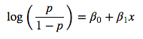
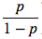
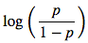
Skipping most of the maths
This is the logit function
p is the probability of being in a category (between 0.0 and 1.0)
We can see that it this function is linear in X
is called the ‘odds’ and can be any value from 0 to ∞
is called the ‘log-odds’ or ‘logit’

Slide 14
SCIKIT LEARN LOGISTIC REGRESSION
import sklearn.linear_model
Regressor = sklearn.linear_model.LogisticRegression()
X = my_dataframe[[‘var1’,’var2’,’var3’]]
Y = my_dataframe.target_column
Regressor.fit(X,y)
Regressor.predict(X)
Regressor.predict_proba(X)

Slide 15
Other things to be aware of
LogisticRegressor(C=100000000)
“I don’t care if I overfit the data”
regressor.predict_proba([[…]])
Returns list: probability of y=0, y=1, y=2…

Slide 16

EXAMPLE
DATA SCIENCE PART TIME COURSE

Slide 17
LAB
Homework/Course Project
DATA SCIENCE

Slide 18
DISCUSSION TIME
Homework/Course Project
DATA SCIENCE

